Slide 1
Choosing a better future
A chance to have your say in the PSA’s Campaign
AMM’s 2024

Slide 2
Choosing a positive future
We all want a society where people can thrive, prosper and be kept safe.
We rely on good investment in housing, healthcare and hospitals, education and schools, water pipes, public transport and roads, science, and preserving the environment.
Like all nations we will build our future on our past. Our nation grew out of the partnership between Māori and the Crown, expressed in Te Tiriti o Waitangi.

Slide 3
Choosing a better future for Aotearoa is at the heart of the public campaign we’re developing to advocate for enhancing, not cutting, public and community services. Central to our advocacy in support for support public and community services and the workers that deliver them we need to choose a vision of a better Aotearoa New Zealand.

Slide 4
Its about having more not less
The government’s policies are not meeting these challenges.
Instead of investment, the government is cutting funding and services to pay for tax cuts.
Instead of meeting the aspirations of its Te Tiriti partners, the government is flirting with rewriting The Treaty Principles without consideration and consultation with Te Iwi Māori (Te Tiriti partner).

Slide 5
We have been quick to respond to the to cuts as they happen. We will continue to challenge each and every one. While we continue to do this, we are also developing a wider campaign that will
Make sure the public stays informed on how policy changes and services affect the people of Aotearoa
Invite the public to participate in actions
Collectivise to make sure this is a one-term government

Slide 6
How will we do this?
We believe it is critical to present an alternative vision developed with members for a better, fairer society and to also call out what we are losing through the government’s planned cuts to funding and services.
We have developed 3 key messages and 4 potential campaign themes that we would now like to get your feedback on
In the following slides these will be presented to you these and then ask you to complete the survey link attached to this presentation
Note: Feedback can be done as a group and your presenter will collate the answers, alternatively you can use the link at the end of the presentation to complete the survey individually.

Slide 7
What are key messages?
Key messages are the main point we want our audience to hear, understand and remember.
These are short and to the point and are intended to share things like, what you do, why you do it, how you are different and the value you offer.
Notes:
Explantaion as to what key messages are and how they work

Slide 8
Have your say - key message
Message 1
Public and community service workers
support the good things
in life that we value and
care about
Clean water, great walks,
a healthy environment.
Systems and structures
that support whānau,
community and the
economy are all
supported by public
service workers.
Message 2
People who work in
Public and community services are in our
communities, making a
difference
Public service workers
are ordinary people in
your community who
work for you and with you.
The work they do makes
a difference in all of our
lives.
Message 3
Public and community service workers
are building our future
Public services at the
centre of achieving what
we need and want for
Aotearoa. They have
skills and knowledge we
need to build a future
Aotearoa that matches
our hopes and
aspirations.
Notes:
During this segment, we ask that members think about how they would feel reading/seeing this statement as a member of the public. Which one resonates with them and why? Discuss and then rank the messages 1-3 in order of relatability. Record any feedback or questions about the statements

Slide 9
What is a campaign theme?
A campaign theme is a positive active statement
It is the central message that provides a coherent frame for all our campaign activity
Our campaign theme intends to educate people about the importance of public services and those who deliver them

Slide 10
Have your say- campaign themes
Theme 1
Back to the future
Drawing on inspiration of “the good old days” a vision from the past for a stronger future enabled by strong public services
Theme 2-
Joining the dots
Making the connection between frontline services and back office cuts, and making that visible in a way that all New Zealanders can understand
Theme 3
Everyday heroes
‘Back-office’ public service workers are
unseen heroes. Their work behind the
scenes enables and supports the
important things in life.
Theme 4
People in the neighbourhood
People working in public services are ordinary people in the community, they are driven by a desire to make Aotearoa a better place
Notes:
During this segment, we ask that members think about how they would feel reading/seeing this statement as a member of the public. Which one resonates with them and why? What would they engage in, what do you relate to? Discuss and then rank the messages 1-4 in order of relatability. Record any feedback or questions about the statements

Slide 11
Providing feedback on campaign
Your delegate will provide all feedback collated today to the PSA communications team
Over the coming months, we will be using this feedback to shape the next steps of the campaign
In the meantime, you can visit our campaigns page to keep up to date on the PSA’s response to cuts in public and community services here
You can also find out more by liking and following our social media channels
Insert social media QR codes and survey QR code
Notes:
Alternatively members can complete the survey link individually

Slide 12
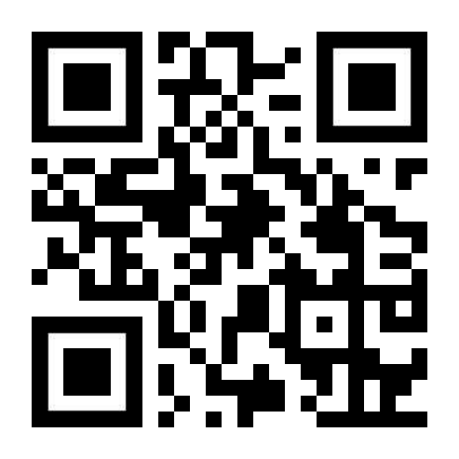
Providing feedback on campaign- links you need
Scan the QR code for a link to the AMM’s survey form
Alternatively visit
https://form.123formbuilder.com/6649562/help-us-shape-our-campaign-amm-s-2024-survey
Notes:
Alternatively members can complete the survey link individually

Slide 13
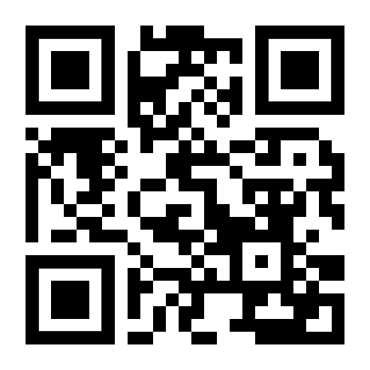
Growing our union
In these times, we need to build our union and our influence.
The most common reason that people give for not joining the PSA is that no one has asked them to.
When you leave this meeting, please tell your colleagues who are not here about the meeting and ask them to join the PSA.
Join the PSA link

